Slide 1

ONLINE SHOP
EASY SOLUTION

Slide 2
Description
This Excel project analyzes and visualizes sales data from an online shopping store. It includes detailed tracking of orders, customer segments, product categories, revenue trends, and regional performance. Using Excel functions like VLOOKUP, pivot tables, slicers, and charts, the project provides an interactive dashboard to monitor KPIs such as total sales, top-selling products, monthly revenue, and customer retention. This project helps stakeholders make data-driven decisions to improve sales strategies and inventory management.

Slide 3
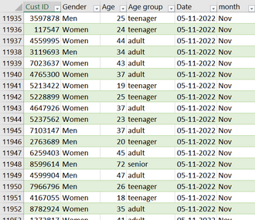
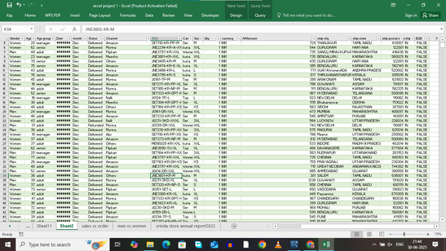
Dataset

Slide 4
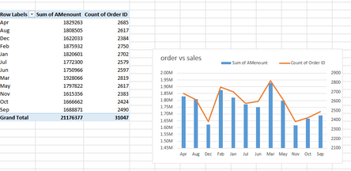
Compare sales and orders using single chart

Slide 5
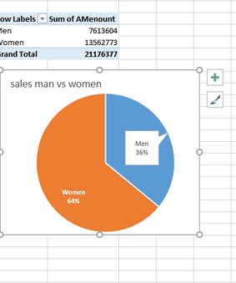
Who purchase more men or women

Slide 6
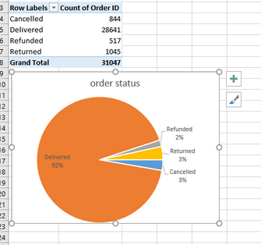
Different order status

Slide 7
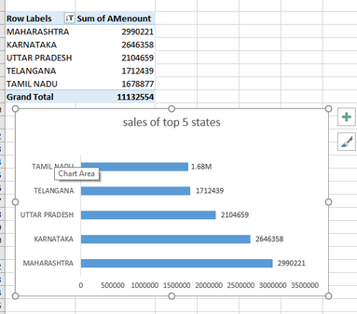
Top 5 states contributing to the sales

Slide 8
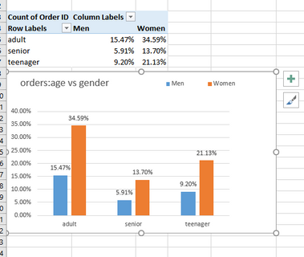
Relationship between age and gender based on no. of orders

Slide 9
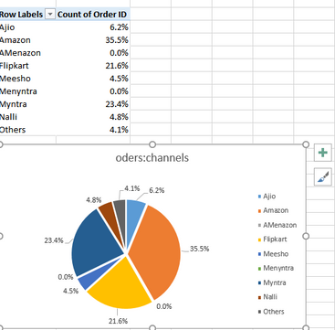
Which channel is contributing to maximum sales

Slide 10
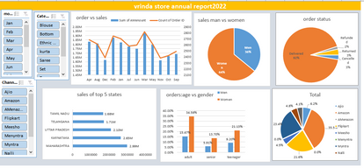
Final report

